Slide 1

Opportunity Recognition
Module -2

Slide 2

Welcome!!

Slide 3
Opportunity Recognition
Business Model
Outlines
What Is a Business Plan?
7 Steps to a Perfectly Written Business Plan
Market opportunity analysis
Identify the customers or potential customers for a business
Recognize a value proposition
Business Model Canvas
Business Model Canvas Examples
Assessment - Activity

Slide 4
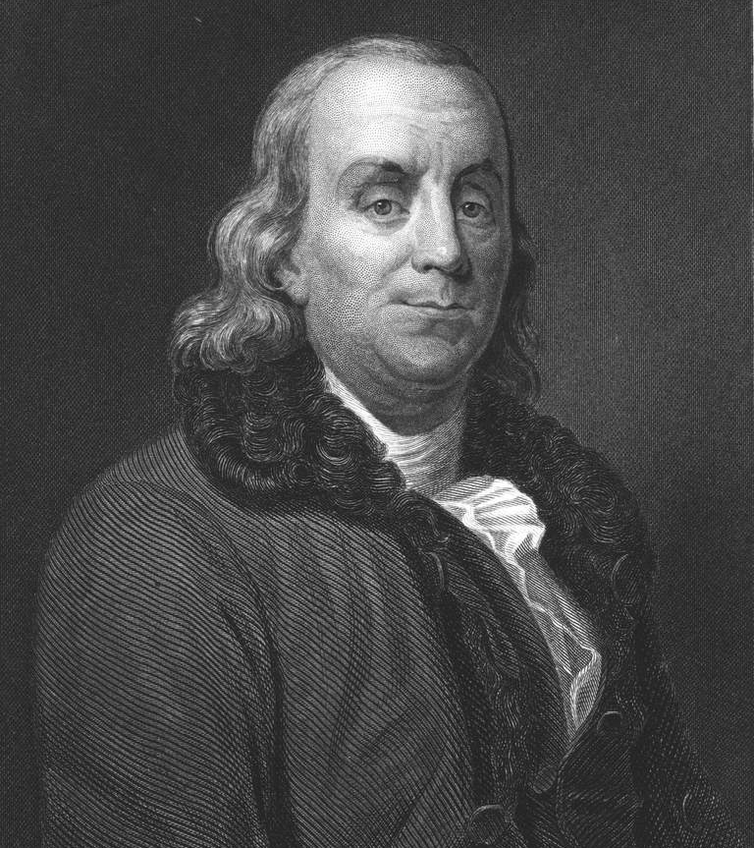
To succeed, jump as quickly at opportunities as you do at conclusions.
Benjamin Franklin

Slide 5

Recognizing Opportunities
A business opportunity is a consumer need or want that can potentially be met by a new business.
In economics, a need is defined as something that people must have to survive, such as water, food, clothing, or shelter.
A want is a product or service that people desire.

Slide 6

Sources of Opportunity

Slide 7
 | Problems
 | A problem could be something you are experiencing personally. Or it could be a problem you observe others experiencing
 | Changes
 | Change often produces needs or wants that no one is currently supplying. Consider climate change and the trend toward taking better care of the environment. Many new business opportunities have occurred because people are interested in purchasing “green” products and services. A problem could be something you are experiencing personally. Or it could be a problem you observe others experiencing

Slide 8
 | New Discoveries
 | For example, someone who has an enjoyable hobby can discover something recognizable as a business opportunity. Inventions also come about because someone wanted to find a way to solve a problem. Other examples include changes in technology or medical and technological discoveries that entrepreneurs find ways to convert into products and services.
 | Existing Products and Services
 | This is not the same thing as copying a product or service and then calling it by another name (which can be illegal). Instead, it means looking for ways to significantly improve a product, perhaps at a lower price. It could also involve improving the quality and manner in which customers are served—including such features as better locations, longer hours, or quicker service.

Slide 9
 | Unique Knowledge
 | Entrepreneurs sometimes turn one-of-a-kind experiences or uncommon knowledge into a product or service that benefits others. Think about your own knowledge and experiences. Is there anything unique or unusual that you could use to create.

Slide 10
Business Model

Slide 11
A Business Model is a conceptual structure that supports the viability of a product or company and explains how the company operates, makes money, and how it intends to achieve its goals. All the business processes and policies that a company adopts and follows are part of the business model.
According to management guru Peter Drucker:
“a business model is supposed to answer who your customer is, what value you can create/add for the customer and how you can do that at reasonable costs.”

Slide 12
Types of Business Models

Slide 13
Manufacturer:
A manufacturer makes finished products from raw materials. It may sell directly to the customers or sell it to a middleman i.e another business that sells it finally to the customer. Ex: Ford, 3M, General Electric.
Distributor:
A distributor buys products from manufacturers and resells them to the retailers or the public. Ex: Auto Dealerships.

Slide 14
Retailer:
A retailer sells directly to the public after purchasing the products from a distributor or wholesaler. Ex: Amazon, Tesco.
Franchise:
A franchise can be a manufacturer, distributor or retailer. Instead of creating a new product, the franchisee uses the parent business’s model and brand while paying royalties to it. Ex: McDonald’s, Pizza Hut.

Slide 15
Brick-and-mortar:
Brick-and-mortar is a traditional business model where the retailers, wholesalers, and manufacturers deal with the customers face-to-face in an office, a shop, or a store that the business owns or rents.
nufacturer:
A manufacturer makes finished products from raw materials. It may sell directly to the customers or sell it to a middleman i.e another business that sells it finally to the customer. Ex: Ford, 3M, General Electric.
E-Commerce:
E-Commerce business model is an upgradation of the traditional brick-and-mortar business model. It focuses on selling products by creating a web-store on the internet.

Slide 16

“Everything is based on a simple rule: Quality is the best business plan, period.”
Steve Jobs

Slide 17

What Is a
Business Plan?
A business plan is a statement of your business goals, the reasons you think these goals can be met, and how you are going to achieve them.

Slide 18


Types of Business Plans

Slide 19
1
This is a brief synopsis lasting no more than thirty seconds to three minutes. It’s used to interest potential investors, customers, or strategic partners. It may seem strange to consider this a type of business plan, but it is. In some cases, the quick summary may be a necessary step toward presenting a more fully developed plan.
Quick
Summary

Slide 20
2
Oral
Presentation
This is a relatively short, colorful, and entertaining slide show with a running narrative.

Slide 21
3
Investor’s
Business
Plan
Anyone who plans to invest in your start-up business (banks, investors, and others) needs to know exactly what you are planning. They need a detailed business plan that is well written and formatted so all the information can be easily understood.

Slide 22
4
Operational
Business
Plan
This plan describes in greater detail than the investor’s business plan how the company will meet its goals. It is also often less formal than an investor’s business plan.

Slide 23
Each type of plan will address The Three C’s.
The Three C’s
Concept.
What is your product or service and how is it different from similar products or services?
Customer.
Who will be buying your product or service and why?
Capital.
How will you locate the initial money your business will need? What will be your costs and what kind of profit can you expect?

Slide 24

Parts of a
Business Plan
Professional investors typically see many business plans each year and make very few investments. They will immediately reject an incomplete or poorly written plan. Investors are busy people and don’t have time to read an overly long business plan. Your plan, including the financials, should be no longer than 20 typed pages (and many are much shorter). It should require no more than an hour of reading time.
Most plans will include these seven parts (although the order may differ, depending on the type of business):

Slide 25
Business Idea. Not only do you describe your product or service in this part of the business plan, but you also talk about the type of business you will start and the type of business ownership you will use. Recently, in this part of the business plan, entrepreneurs have begun to describe how their business is socially responsible.
Opportunity & Market Analysis. Your description of the market should include an account of the market, its size, its trends and characteristics, and its growth rate. Describe your market research. List your competitors and describe your competitive advantage. Provide your marketing plan, your product and pricing strategies, and your plans for promotion.

Slide 26
Financial Strategies. This section shows any historical financial data, as well as projected figures including estimated sales and expenses (typically extending for five years). This section also describes any financing required by the business.
Organizational Structures. In this part of the business plan you discuss the organizational structure of the company. You can provide profiles of key managers and, if appropriate, information about your board of directors. You can also describe how you plan to train and motivate your employees, if appropriate.

Slide 27
Legal Structures. In this part of the business plan you describe any intellectual property or contract issues. You also talk about how your business will be protected by insurance, the affect of taxes on your business, and any relevant government regulations that affect the business.
Business Management. Describe how the business will be managed (focusing on production, distribution, operations, purchasing, and inventory).

Slide 28
Plan for Growth. Here you describe your plans to grow the business and the challenges it may face. You may also describe your plans to franchise or license the business, if that is part of its plan for growth.

Slide 29

Steps to a Perfectly Written Business Plan

Slide 30
We recommends that a business plan include:
Executive summary -- a snapshot of your business
Company description -- describes what you do
Market analysis - research on your industry, market and competitors
Organization and management -- your business and management structure
Service or product -- the products or services you’re offering
Marketing and sales -- how you’ll market your business and your sales strategy
Funding request -- how much money you’ll need for next 3 to 5 years
Financial projections -- supply information like balance sheets
List of addenda -- an optional section that includes résumés and permits

Slide 31

Getting started may be difficult to do
So, here are seven steps for writing a perfect business plan.

Slide 32
Research, research, research.
“Research and analyze your product, your market and your objective expertise,” William Pirraglia, a now-retired senior financial and management executive, has written. “Consider spending twice as much time researching, evaluating and thinking as you spend actually writing the business plan.
“To write the perfect plan, you must know your company, your product, your competition and the market intimately.”

Slide 33
2. Determine the purpose of your plan.
A business plan, as defined by Entrepreneur, is a “written document describing the nature of the business, the sales and marketing strategy, and the financial background, and containing a projected profit and loss statement.” However, your business plan can serve several different purposes
But, if you want to attract investors, your plan will have a different purpose and you’ll have to write a plan that targets them so it will have to be as clear and concise as possible. When you define your plan, make sure you have defined these goals personally as well.

Slide 34
3. Create a company profile.
Your company profile includes the history of your organization, what products or services you offer, your target market and audience, your resources, how you’re going to solve a problem and what makes your business unique. Company profiles are often found on the company’s official website and are used to attract possible customers and talent. However, your profile can be used to describe your company in your business plan. It’s not only an essential component of your business plan; it’s also one of the first written parts of the plan.

Slide 35
4. Document all aspects of your business.
Investors want to make sure that your business is going to make them money. Because of this expectation, investors want to know everything about your business. To help with this process, document everything from your expenses, cash flow and industry projections. Also, don’t forget seemingly minor details like your location strategy and licensing agreements.

Slide 36
5. Have a strategic marketing plan in place.
A great business plan will always include a strategic and aggressive marketing plan. This typically includes achieving marketing objectives such as:
Introducing new products
Extending or regaining market for existing products
Entering new territories for the company
Boosting sales in a particular product, market or price range. Where will this business come from? Be specific.
Cross-selling (or bundling) one product with another
Entering into long-term contracts with desirable clients
Raising prices without cutting into sales figures
Refining a product
Having a content marketing strategy
Enhancing manufacturing/product delivery
“Each marketing objective should have several goals (subsets of objectives) and tactics for achieving those goals,” states Entrepreneur.

Slide 37
6. Make it adaptable based on your audience.
“The potential readers of a business plan are a varied bunch, ranging from bankers and venture capitalists to employees,” states Entrepreneur. “Although this is a diverse group, it is a finite one. And each type of reader does have certain typical interests. If you know these interests up-front, you can be sure to take them into account when preparing a plan for that particular audience.”
For example, bankers will be more interested in balance sheets and cash-flow statements, while venture capitalists will be looking at the basic business concept and your management team. The manager on your team, however, will be using the plan to “remind themselves of objectives.”

Slide 38
7. Explain why you care.
Whether you’re sharing your plan with an investor, customer or team member, your plan needs to show that you’re passionate and dedicated, and you actually care about your business and the plan. You could discuss the mistakes that you've learned, list the problems that you’re hoping to solve, describe your values, and establish what makes you stand out from the competition.
When I started my payments company, I set out to conquer the world. I wanted to change the way payments were made and make it easier for anyone, anywhere in the world to pay anyone with few to no fees. I explained why I wanted to build this. My passion shows through everything I do.

Slide 39

Market
opportunity analysis
As you work on your business plan, a major section needs to be devoted to identifying future opportunities for your company. This is key to developing a long term strategy, because without any planning you’re likely to only have short term success. Not something a typical business owner wants to hear. If you’re still waiting to make a start on your business plan.

Slide 40
Identify what’s currently happening in the business environment.
In this section you need to look at the economic conditions (growth, stable or decline) as well as any trends or social changes that could have an impact on the business. Delve into both the legal and regulatory situations, as these can often change and you need to be prepared for any future expected changes as well. Research the latest technology and state of the art developments, and take into account the natural environment. Are there any vulnerabilities or limitations on resources that could hinder your growth?

Slide 41
2. Define the industry and determine the outlook.
Here you need to state exactly the industry that you are operating within, and make forecasts on the size of the market. Look back over the last 5 years, and project how you believe it will grow over the next 12 months, 3 years and 5 years. Look to your competition and discover the marketing practices that are being utilized, and see if you can see any major trends or shifts within your industry. Here there are major implications for potential opportunities, as you need to ensure you’re moving in the same direction as the market.

Slide 42
3. Dive into the details of your competitors.
You need to know what businesses you are competing with, and know their products inside and out. Go through their product mix, and compare this with the products you are offering. Make sure you’re objective in your approach, and also identify the relative strengths and weaknesses of the products from your customers’ point of view. Look at how your competition is reaching the market, the channels they’re using to both distribute and market their products, and the level of service that’s being offered. If you have details on the market share of other businesses include it here, and sum it all up in a couple of short sentences that outline the implications of this section regarding the opportunities in the market.

Slide 43
4. Describe your target market.
You need to build a profile of your ideal customer, so that you can adequately focus your sales and marketing efforts and reach your customers. If you haven’t built a marketing plan before. In essence you simply need to look at the needs of your customers, but if you get stuck try asking yourself one of these questions:
Who are my potential customers?
What are my potential customers like as a consumer?
What are my potential customers looking for?
When is the product needed?
Is there a particular channel that the product sells best in?
How do my potential customers make a decision to buy a product?
How important is each of my products attributes to my potential customers?
Are there any outside influences that have an effect on their buying decision?
Is there any limitations that can influence the level of opportunity?
What is the competition starting to do?
How is the market developing and changing?

Slide 44
5. Create your projections.
Use a variety of techniques that build on all of the information in your business plan to set a forecast of your sales. This includes best and worst case scenario analysis, any intuition or “gut-feelings” you have about new markets, and compare any results you have seen to date. The final recommendation in a market opportunity analysis is a simple answer to this question. Is the project a go? Or a no go?

Slide 45

Identifustomey the crs or potential
customers for a business
Entrepreneurs who operate small-scale, or lifestyle, ventures face different risks and stresses. Talented people usually avoid companies that offer no stock options and only limited opportunities for personal growth, so the entrepreneur’s long hours may never end. Because personal franchises are difficult to sell and often require the owner’s daily presence, founders may become locked into their businesses. They may face financial distress if they become sick or just burn out. “I’m always running, running, running,” complains one entrepreneur, whose business earns him half a million dollars per year. “I work 14-hour days, and I can’t remember the last time I took a vacation. I would like to sell the business, but who wants to buy a company with no infrastructure or employees?”

Slide 46
10 Steps To Target And Connect With Potential Customers Effectively
Are you starting to roll out your marketing
plan and netting yourself some customers? Follow these 10 steps to be successful.

Slide 47
2. Research Your Competitors And Find Out Who Their Customers Are
An easy way to find out which kind of marketing campaign works and which don’t is by researching competitors in your industry.
Not only will this inexpensive effort give you some ideas to follow for your own campaigns, this research will also reveal dark spots in your competitor’s process and present new directions for you to take your own marketing strategy.
Survey Customers
You won’t be able to connect effectively with your potential customers if you don’t have a customer in mind. Survey current customers, as well as members of your target market, to find out how you can better present your product or service, or what aspects might be missing from what you’re currently offering.

Slide 48
3. Target Ads
Far cheaper than most methods of advertising, Facebook and Google targeted ads prove that a little can go a long way.
While most advertising in the real world only reaches whoever comes across a billboard, bus stop or commercial, these targeted ads can locate the people who are most likely to need your service based on geographical location, demographics (including age, gender, education and relationship status), interests (based on what they’ve shared or “liked”) and browsing activity.
4. Smart Social Media
There’s having a presence on social media, and then there’s having a social media presence. When it comes to keeping customers, a little more effort on Facebook, Twitter and Instagram really go the distance.

Slide 49
5. Respond To Every Email, Tweet, Facebook Comment, And Phone Call; Adjust Yourself As Necessary
When Paul English was still presiding over Kayak, one of the most valuable practices he insisted on implementing was to keep an extremely annoying, loud phone in the middle of the office to receive customer complaints. This ensured the calls were answered — by anybody, including engineers, developers, content managers, or even English himself.
At Zappos, Tony Hsieh values customer service so much that they build in customer service training for every new hire, regardless of the job. And its customer service has gone to such lengths as to go to a rival shoe store to get a pair of shoes that the site had run out of.
The point? Always answer calls, always care for your customers, and always fix problems as they come in — your customers will love you for it.
6. Affiliate Marketing
Affiliate marketing has been around since the early days of the Web, and it’s still an overlooked but highly effective means to raise your brand awareness significantly.
And with the number of affiliate networks out there, who operate on a PPC (Pay Per Click) or PPA (Pay Per Action) basis, it has never been easier or safer to find your product being promoted by appropriate publishers.
EBay, Amazon and certain marketing companies offer their own affiliate networks, but you can also try an exclusive PPA affiliate network.

Slide 50
7. Establish Trust In Your Community: Publish User Reviews, Get Likes, Syndicate Articles
With so many new, competing businesses congesting almost every industry, it’s getting increasingly difficult to stand out and grow a decent-sized following. To gain support, companies first have to establish trust.
As more than 88 percent of consumers trust online reviews as much as personal recommendations, it only makes sense to start by publishing user reviews and sending samples of your product for trusted bloggers to review.
8. Connect With The Right Influencers
Engaging with big players in your industry can be an extremely effective way to garner a wider share base. After all, if you can get the attention of a thought leader or an influencer, you have the chance to capture their fans and friends, as well as establish trust and credibility.
Reach out to appropriate bloggers or entrepreneurs at conferences or over Twitter, send them relevant and interesting blog content that might pique their interest, and once again — be a human being, not just your company.

Slide 51
9. Post Relevant Content On Blogs
Keeping a practice of continually and diligently publishing relevant and original blog content not only helps keep your company shining in the warm Google sun, but it also helps potential customers truly get to know your company and where it’s coming from.
The content doesn’t have to be self-promotional (and shouldn’t be), but it should offer context into why your product or service is important, suggest the best ways to solve industry-related problems that arise in the everyday lives of your target demographic, impart some valuable wisdom, and generally inspire people to share your point of view.
10. Craft An Engaging Newsletter To Foster Leads
One of the most time-consuming aspects of online marketing is generating leads. Often, that involves analyzing customer demographics and social media activity, putting out ads and online surveys and updating user data from year to year.

Slide 52
Identifying Your Competition
Types of Competition
- Direct competitors. A business in your market that sells a product or service similar to yours is your direct competitor. McDonald’s® and Burger King® are examples of direct competitors in the fast food industry, because they sell a similar line of products. An ice cream shop that also sells hamburgers might also be considered direct competition for McDonald’s and Burger King. However, the ice cream shop would not be considered a strong competitor, because its main focus is on ice cream products. Hamburgers are only a sideline.
- Indirect competitors. A business that sells a different product or service from yours but fills the same customer need or want is your indirect competitor. For example, Taco Bell® is in the fast-food industry, but it is an indirect competitor with McDonald’s and Burger King. This is because Taco Bell sells fast-food products but not hamburgers. On a broader level, non-fast-food restaurants could also be considered indirect competition because the food they sell fills the same basic need.

Slide 53
Identifying Your Competition
Types of Competition
- Direct competitors. A business in your market that sells a product or service similar to yours is your direct competitor. McDonald’s® and Burger King® are examples of direct competitors in the fast food industry, because they sell a similar line of products. An ice cream shop that also sells hamburgers might also be considered direct competition for McDonald’s and Burger King. However, the ice cream shop would not be considered a strong competitor, because its main focus is on ice cream products. Hamburgers are only a sideline.
- Indirect competitors. A business that sells a different product or service from yours but fills the same customer need or want is your indirect competitor. For example, Taco Bell® is in the fast-food industry, but it is an indirect competitor with McDonald’s and Burger King. This is because Taco Bell sells fast-food products but not hamburgers. On a broader level, non-fast-food restaurants could also be considered indirect competition because the food they sell fills the same basic need.

Slide 54
Recognize a value proposition
What Is a Value Proposition?
A value proposition is the promise you make to deliver products and services of value to your customers. This promise is what allows you to edge out your competitors by describing what sets you apart and how you will solve a problem the consumer has.

Slide 55
How to Determine Your Value Proposition
Use these steps to help you better develop your value proposition:
Identify customer benefits: Make a list of all of the ways your customers can benefit from your product.
Link benefits to the value offered: Consider the ways in which your products will bring value to the customer.
Differentiate and position yourself: Clearly establish who your target audience is, what you are offering them, and how you stand out compared to your competition.

Slide 56

Business
Model Canvas
A business model describes how a company creates, delivers and captures value.

Slide 57
WHAT IS A BUSINESS MODEL CANVAS?
The Business Model Canvas, developed by Alexander Osterwalder, is a visual representation of current or new business models, generally used by strategic managers. The Canvas provides a holistic view of the business as a whole and is especially useful in running a comparative analysis on the impact of an increase in investment may have on any of the contributing factors.
The Business Model Canvas gives people a common language through which they can evaluate traditional processes and bring innovation into their business models.

Slide 58
THE TRADITIONAL APPROACH TO A BUSINESS MODEL
Most startups fail because entrepreneurs put all their faith in the idea of the product the organization exists to create. In their loyalty to this product or service, they fail to give in depth consideration to the business model their organization will follow. Usually the business model is either a one-size-fits-all model, common in the industry or it is a random amalgamation of systems and processes, created at the spur of the moment to further the main goal; sell the product or service.
Successful new ventures do not go to market with their first idea; instead, the product/ service has usually gone through several iterations before arriving at the final version. Similarly, organizations are more sustainable if they have considered several business models before deciding on a particular one.

Slide 59
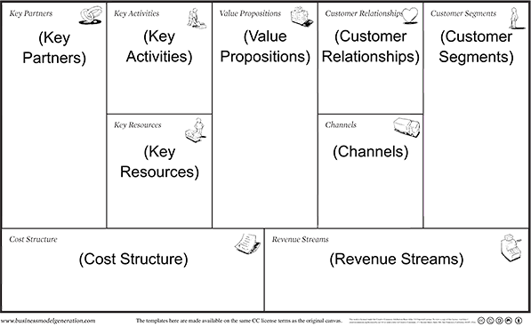
THE 9 BUILDING BLOCKS
The Business Model Canvas categorizes the processes and internal activities of a business into 9 separate categories, each representing a building block in the creation of the product or service. These categories represent the four major aspects of a business; customers, offer, infrastructure, as well as financial viability.

Slide 60
1. Customer Segments
The total customer pie is divided into segments based on the manner in which an organization’s products or services address a specific need for the segment. The customer segment is an essential part of an organization’s business model and is key to ensuring that the product features are aligned with the segments characteristics and needs.

Slide 61
2. Value Propositions
An organization’s value proposition is the combination of products and services it provides to its customers. Osterwalder stated that these offerings need to be unique and easily differentiated from competition. Value propositions can be divided into two categories:
Quantitative: this stresses the price or efficiency of the product or service
Qualitative: this value proposition highlights the experience and results the product and its use, produce.
The value proposition provides value through a number of attributes such as customization, performance, “getting the job done”, brand/ status, design, newness, price, cost and risk reduction, accessibility, as well as convenience/ usability.
.

Slide 62
3. Channels
The medium through which an organization provides its value proposition to its customer segment is known as a channel. There are various options for channels available to an organization, and the selection is based on the channel that is the quickest, most efficient with the least amount of investment required. There are two basic kinds of channels; Company owned channels such as store fronts or Partner Channels such as Distributors. A company can opt to choose either one or employ a combination of both.

Slide 63
4. Customer Relationships
An organization must select the kind of relationship it will have with its customer segment in order to create financial success and sustainability ,Customer Relationships can be categorized as follows:

Slide 64
4. Customer Relationships
An organization must select the kind of relationship it will have with its customer segment in order to create financial success and sustainability ,Customer Relationships can be categorized as follows:
Personal Assistance: In this kind of relationship the company interacts with the customer directly through an employee who provides the human touch by assisting the customer presale, during the sale and even may provide after sales services.
Dedicated Personal Assistance: This kind of relationship is characterized by a very close interaction between the customer and the company through a dedicated representative who is assigned a set of clients and is pers
onally responsible for the entire experience the customer has with the company.

Slide 65
Self-Service: Self-Service places the onus of the customer experience on the tools the company provides for the customer to serve him or herself.
Automated Services: These are customized self-service relationships where the historical preference of the customer is taken into account to improve the overall experience.
Communities: In today’s electronic age creating communities of clients allows organizations to communicate with them directly. This allows for an enhanced client experience because the community allows clients to share their experiences and come up with common challenges and solutions.
Co-creation: The customer has a direct hand in the form the company’s product or service will take.
For an entrepreneur, the priority is to identify the type of relationship he/ she has with the customer. Then the value of the customer must be evaluated in terms of the frequency of his expenditure on the firms product and services. Loyal customers are relationships that the company should aim to invest in as they will yield steady revenue throughout the year.

Slide 66
5. Revenue Streams
A revenue stream is the methodology a company follows to get its customer segments to buy its product or service. A revenue stream can be created through the following ways:
Asset Sale: the company sells the right of ownership over the good to the customer.
Usage Fee: the company charges the customer for the use of its product or service.
Subscription Fee: the company charges the customer for the regular and consistent use of its product or service.
Lending/ Leasing/ Renting: the customer pays to get exclusive access to the product for a time-bound period.
Licensing: the company charges for the use of its intellectual property.
Brokerage Fees: companies or individuals that act as an intermediary between two parties charge a brokerage fee for their services.
Advertising: a company charges for others to advertise their products using their mediums.

Slide 67
5. Revenue Streams
A revenue stream is the methodology a company follows to get its customer segments to buy its product or service. A revenue stream can be created through the following ways:
Asset Sale: the company sells the right of ownership over the good to the customer.
Usage Fee: the company charges the customer for the use of its product or service.
Subscription Fee: the company charges the customer for the regular and consistent use of its product or service.
Lending/ Leasing/ Renting: the customer pays to get exclusive access to the product for a time-bound period.
Licensing: the company charges for the use of its intellectual property.
Brokerage Fees: companies or individuals that act as an intermediary between two parties charge a brokerage fee for their services.
Advertising: a company charges for others to advertise their products using their mediums.

Slide 68
6. Key Resources
These are the assets of the organization fundamental to how it provides value to its customers. Resources can be categorized as human, financial, physical and intellectual.
For an entrepreneur, it is important to begin with listing your resources. This gives you a clear idea of what final product or service your company needs to create for the customer and which resources are dispensable, resulting in cost savings for your company. Once the final list of resources is available, the company can decide on how much it needs to invest in these key resources to operate a sustainable business.

Slide 69
7. Key Activities
Activities that are key to producing the company’s value proposition. An entrepreneur must start by listing the key activities relevant to his/her business. These activities are the most important processes that need to occur for the business model to be effective. Key activities will coincide with revenue streams. Now it is important to evaluate which activities are key by adding or removing some and evaluating their impact.

Slide 70
8. Key Partnerships
To create efficient, streamlined operations and reduce risks associated with any business model, an organization forms partnerships with its high-quality suppliers. Key partnerships are the network of suppliers and partners who complement each other in helping the company create its value proposition. Partnerships can be categorized as follows;
Strategic alliance between competitors (also known as coopetition),
Joint ventures .
Relationships between buyers and suppliers.

Slide 71
9. Cost Structure
This defines the cost of running a business according to a particular model. Businesses can either be cost driven i.e. focused on minimizing investment into the business or value driven i.e. focused on providing maximum value to the customer.
Following are some traits of common cost structures;
Fixed Costs: costs that remain the same over a period of time
Variable Costs: as the name suggests, these costs vary according to a variance in production
Economies of Scale: costs decrease as production increases
Economies of Scope: costs are decreased by investing in businesses related to the core product.

Slide 72

How do I add Pain Relievers to my Value Proposition Canvas?
Pain relievers describe how your products and services alleviate specific customer pains. They explicitly outline how you intend to eliminate or reduce some of the pains that annoy your customers before, while, and after they are trying to get a job done. Typically, great value propositions alleviate only a limited number of severe customer pains but do that very well. Make sure you focus on pains you have identified in the customer profile.

Slide 73

Questions to ask
Produce savings? E.g. in terms of time, money, or efforts.
Make your customers feel better? E.g. by killing frustrations, annoyances, things that give customers a headache.
Fix underperforming solutions? E.g. by introducing new features, better performance, or better quality.
Put an end to difficulties and challenges your customers encounter? E.g. by making things easier or eliminating obstacles.
Wipe out negative social consequences your customers encounter or fear? E.g. in terms of loss of face, lost power, trust, or status.

Slide 74
Eliminate risks your customers fear? E.g. financial, social, technical risks, or what could go awfully wrong.
Help your customers better sleep at night? E.g. by helping with big issues, by diminishing concerns, or eliminating worries.
Limit or eradicate common mistakes customers make? E.g. by helping use a solution the right way.
Get rid of barriers that are keeping your customer from adopting solutions? E.g. lower or no upfront investment costs, flatter learning curve, or the elimination of other obstacles preventing adoption.

Slide 75

Business Model Canvas Examples
Example 1: Google

Slide 76
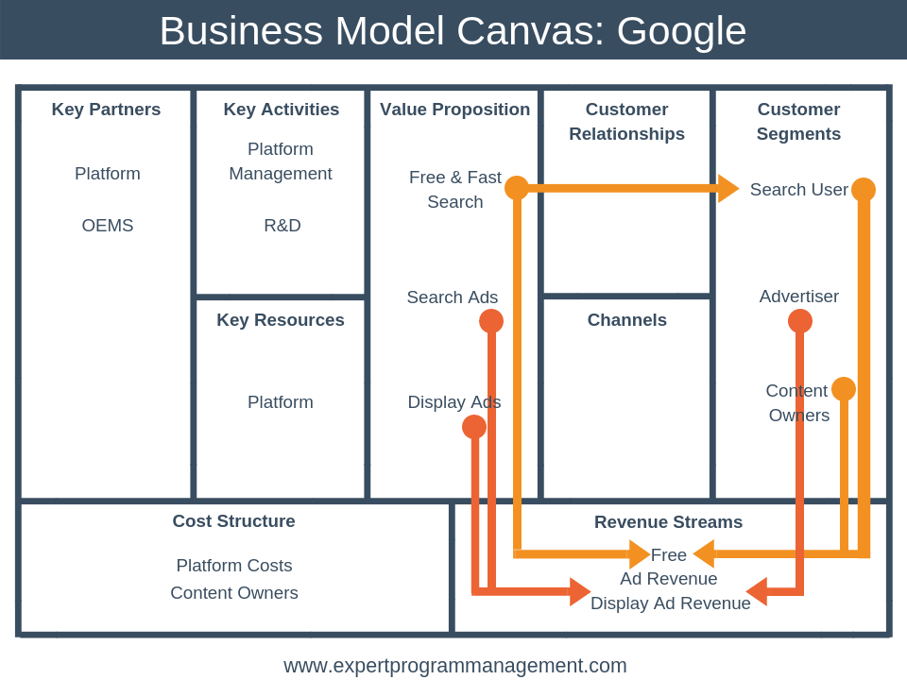
The first thing you should know about Google’s business model is that it is multi-sided. This means that it brings together two distinct but related customers.
In Google’s case, its customers are its search users and its advertisers. The platform is only of interest to advertisers because search users are also present. Conversely, search users would not be able to use the platform free of charge were it not for advertisers.

Slide 77
As you can see the diagram gives you an immediate understanding of the key parts of Google’s business model.
We can see that:
Google makes money from the advertiser customer segment, whose ads appear either in search results or on web pages.
This money subsidizes a free offering to the other two customer segments: search users and content owners.
Google’s business model has a network element to it. That is, the more ads it displays to web searchers the more advertisers it attracts. And the more advertisers it attracts the more content owners it attracts.
Google’s Key Resource is its search platform including google.com, Adsense (for content owners) and Adwords (for advertisers).
The key strategic activities that Google must perform are managing the existing platform including its infrastructure.
Google’s key partners are obviously the content owners from whom a large part of its revenues is generated. OEMs (Original Equipment Manufacturers) also form a key partner.
OEMs are companies who produce mobile handsets to whom Google provides its Android operating system to for free. In return, when users of these handsets search the internet they use the Google search engine by default, thus bring more users into the ecosystem and generating even more revenue.

Slide 78

Business Model Canvas Examples
Example 2: Skype

Slide 79
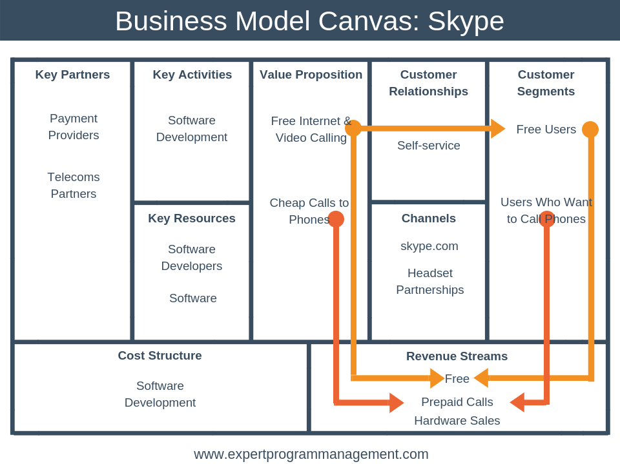

Slide 80
From the Business Model Canvas, we can see that Skype has two key value propositions:
The ability to make calls over the Internet, including video calls, for free.
The ability to make calls to phones cheaply.
Skype operates a freemium business model, meaning the majority of Skype’s users (the Free Users customer segment) use the service for free to make calls over the internet, with just 10% of users signing up to the prepaid service.
We can see from the customer relationship building block that customers typically have a help themselves relationship with Skype. Typically, this will be by using their support website.
The channels Skype uses to reach its customers are its website, skype.com, and partnerships with headset brands.
Looking at key partnerships, key activities, and key resources together, the main thing to notice is that Skype is able to support its business model of offering cheap and free calls because it doesn’t have to maintain its own telecoms network like a traditional telecoms provider. Skype doesn’t need that much infrastructure at all, just backend software and the servers hosting use accounts.

Slide 81

Business Model Canvas Examples
Example 3: Gillette

Slide 82
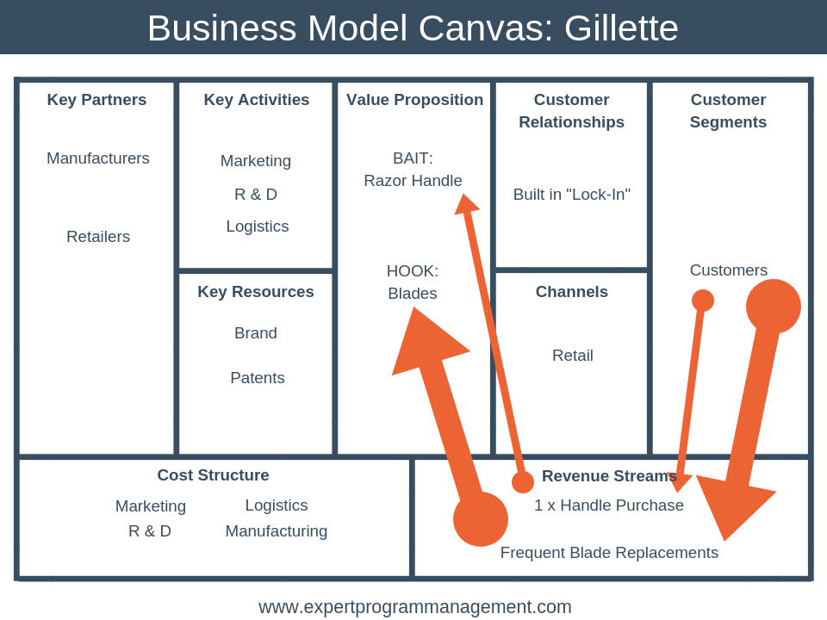

Slide 83
Gillette’s business model is based on the “Bait & Hook” business model pattern. This model is characterized by an attractive, inexpensive or even free initial offer that encourages ongoing future purchases of related products or services. With this business model, the bait is often provided at a loss, subsidized by the hook.
In Gillette’s case, an inexpensive razor handle forms the bait, and continued purchases of the blades represent the hook.
The business model is very popular in SaaS (Software as a Service) businesses, where typically a free initial month leads to a monthly subscription.
In the diagram above we have used the thickness of the arrows to indicate the size of revenue generated. In Gillette’s case, all revenues are generated by just one customer segment, but the vast majority of revenues come from Frequent Blade Replacements, with just minor revenues coming from the purchase of handles.
If you look at the left-hand side of Gellettes Business Model Canvas you will notice how all major costs are aligned with delivering the value proposition. For example, marketing costs help to build Gillette’s strong brand and R&D costs help to ensure that the blade and handle technology is unique and proprietary.

Slide 84
Assessment
Activity
_{Assessment}
Compare the advantages and disadvantages of buying an independent business versus buying a franchise. How are these business opportunities alike? How are they different?
What type of business opportunities match well with your current goals, both financial and nonfinancial?
Describe the two types of competitors.
What is a competitive advantage?
In order, list the six basic steps used in market research.

